Slide 1


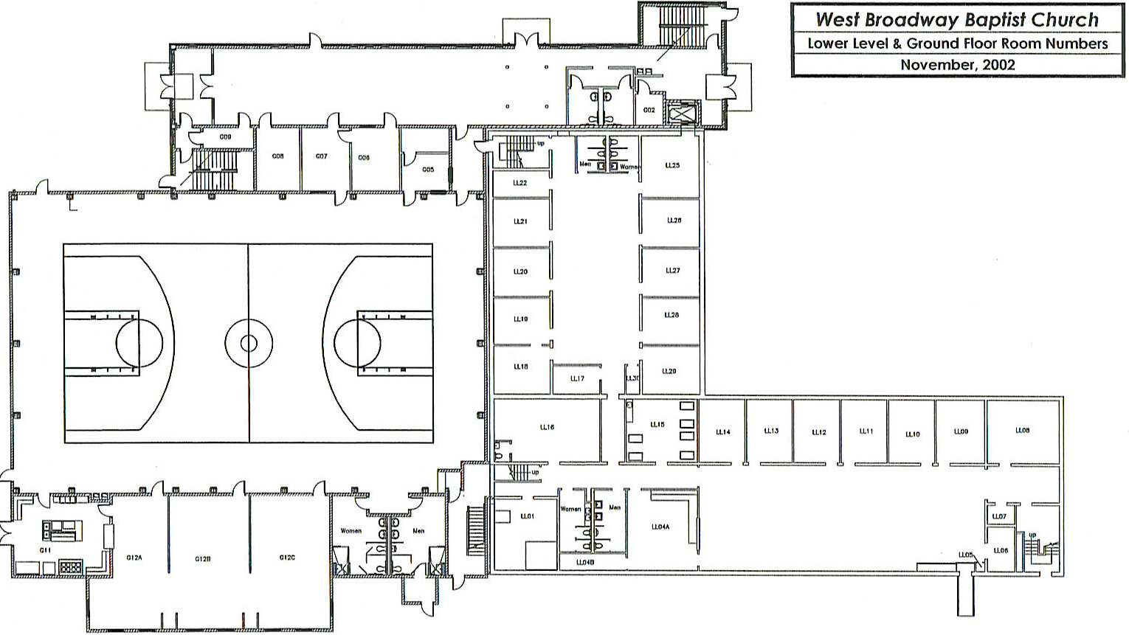



First Aid
A-1
Tornado Routine
All children will remain in the
basement and move to a safe area.
The Director or Assistant Director
will monitor the battery powered radio in the school office.
Earthquake Routine
The children will go under tables and remain until all clear is given by the teacher. The teacher and teaching assistant will stand in doorway until danger has past.
D-3
D-2
C-4
D-1
A-2
C-3
SAFE
AREA
SAFE
AREA
C-2
SAFE
AREA
C-1
Escape Routes
B-1
B-4
Alternate
B-2
Primary

Slide 2
First Aid
A-1
Tornado Routine
All children will remain in the
basement and move to a safe area.
The Director or Assistant Director
will monitor the battery powered radio in the school office.
Earthquake Routine
The children will go under tables and remain until all clear is given by the teacher. The teacher and teaching assistant will stand in doorway until danger has past.
D-3
D-2
C-4
D-1
A-2
C-3
SAFE
AREA
C-2
SAFE
AREA
SAFE
AREA
C-1
Escape Routes
B-1
B-4
Alternate
B-2
Primary

Slide 3
First Aid
Tornado Routine
All children will remain in the
basement and move to a safe area.
The Director or Assistant Director
will monitor the battery powered radio in the school office.
A-2
Earthquake Routine
The children will go under tables and remain until all clear is given by the teacher. The teacher and teaching assistant will stand in doorway until danger has past.
A-1
D-2
D-3
C-4
D-1
C-3
SAFE
AREA
SAFE
AREA
C-2
SAFE
AREA
C-1
Escape Routes
B-4
Alternate
B-2
B-1
Primary

Slide 4
First Aid
Tornado Routine
All children will remain in the
basement and move to a safe area.
The Director or Assistant Director
will monitor the battery powered radio in the school office.
Earthquake Routine
The children will go under tables and remain until all clear is given by the teacher. The teacher and teaching assistant will stand in doorway until danger has past.
A-1
D-3
D-2
C-4
A-2
D-1
C-3
SAFE
AREA
SAFE
AREA
C-2
SAFE
AREA
C-1
Escape Routes
B-2
B-1
B-4
Alternate
Primary

Slide 5
First Aid
Tornado Routine
All children will remain in the
basement and move to a safe area.
The Director or Assistant Director
will monitor the battery powered radio in the school office.
Earthquake Routine
The children will go under tables and remain until all clear is given by the teacher. The teacher and teaching assistant will stand in doorway until danger has past.
A-1
D-3
D-1
C-4
A-2
D-1
C-3
SAFE
AREA
C-2
SAFE
AREA
SAFE
AREA
C-1
B-4
Escape Routes
B-2
B-1
Alternate
Primary

Slide 6
First Aid
A-1
Tornado Routine
All children will remain in the
basement and move to a safe area.
The Director or Assistant Director
will monitor the battery powered radio in the school office.
Earthquake Routine
The children will go under tables and remain until all clear is given by the teacher. The teacher and teaching assistant will stand in doorway until danger has past.
D-3
D-2
C-4
A-2
D-1
C-3
SAFE
AREA
C-2
SAFE
AREA
SAFE
AREA
C-1
Escape Routes
B-2
B-1
B-4
Alternate
Primary

Slide 7
First Aid
Tornado Routine
All children will remain in the
basement and move to a safe area.
The Director or Assistant Director
will monitor the battery powered radio in the school office.
Earthquake Routine
The children will go under tables and remain until all clear is given by the teacher. The teacher and teaching assistant will stand in doorway until danger has past.
A-1
D-3
D-2
C-4
A-2
D-1
C-3
SAFE
AREA
C-2
SAFE
AREA
SAFE
AREA
C-1
Escape Routes
B-1
B-4
Alternate
B-2
Primary

Slide 8
First Aid
Tornado Routine
All children will remain in the
basement and move to a safe area.
The Director or Assistant Director
will monitor the battery powered radio in the school office.
Earthquake Routine
The children will go under tables and remain until all clear is given by the teacher. The teacher and teaching assistant will stand in doorway until danger has past.
A-1
D-3
D-2
C-4
A-2
D-1
C-3
SAFE
AREA
C-2
SAFE
AREA
SAFE
AREA
C-1
Escape Routes
B-1
B-4
Alternate
B-2
Primary

Slide 9
First Aid
A-1
Tornado Routine
All children will remain in the
basement and move to a safe area.
The Director or Assistant Director
will monitor the battery powered radio in the school office.
Earthquake Routine
The children will go under tables and remain until all clear is given by the teacher. The teacher and teaching assistant will stand in doorway until danger has past.
D-2
D-3
C-4
A-2
D-1
C-3
SAFE
AREA
C-2
SAFE
AREA
SAFE
AREA
C-1
Escape Routes
B-1
B-4
Alternate
B-2
Primary

Slide 10
First Aid
Tornado Routine
All children will remain in the
basement and move to a safe area.
The Director or Assistant Director
will monitor the battery powered radio in the school office.
Earthquake Routine
The children will go under tables and remain until all clear is given by the teacher. The teacher and teaching assistant will stand in doorway until danger has past.
A-1
D-2
D-3
C-4
A-2
D-1
C-3
SAFE
AREA
C-2
SAFE
AREA
SAFE
AREA
C-1
B-4
Escape Routes
B-2
B-1
Alternate
Primary

Slide 11
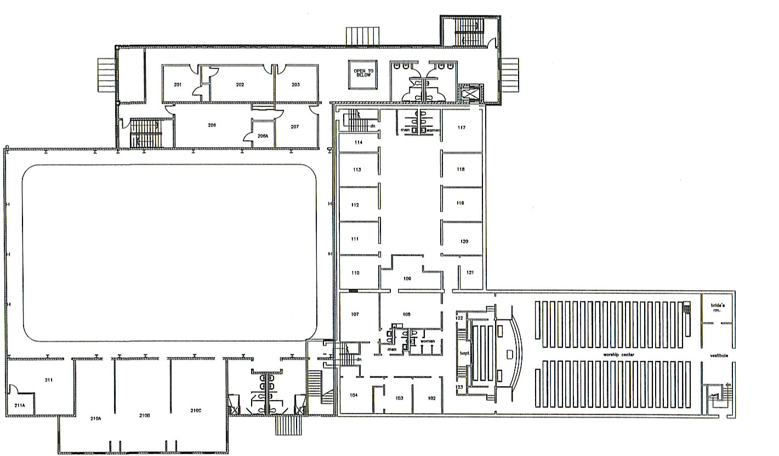

First Aid
HISTORIC DRIVE
A-1
ELEVATOR
N
2nd FLOOR NARTHEX
1ST & 2ND FLOORS
201
202
203
D-1
206
206A
207
OLD
CHOIR
ROOM
A-3
SIX MILE LANE
SANCTUARY
211
210A
210B
210C
211A
B-3
B-1
B-4
Escape Routes
Alternate
Primary

Slide 12

HISTORIC DRIVE
First Aid
D-3
ELEVATOR
A-1
N
2nd FLOOR NARTHEX
A-2
201
202
203
206
206A
207
1ST & 2ND FLOORS
OLD
CHOIR
ROOM
A-3
SIX MILE LANE
SANCTUARY
211
210A
210B
210C
211A
B-3
B-1
B-4
Escape Routes
Alternate
Primary

